Slide 1
Second demo
09-11-2018
Gábor Mazúr

Slide 2
About me
Gábor Mazúr
Age: 33
Geophisycist, environmental engineer
Previously worked for 7 years as a projekt manager on environmental projekts

Slide 3
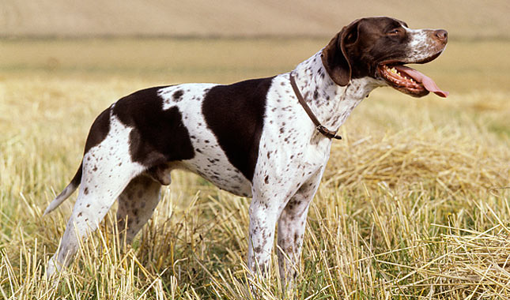
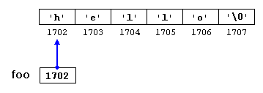
3. week’s summary
Presentation course
Pointers
Drawing and drawing
A LOT OF PRACTICE

Slide 4
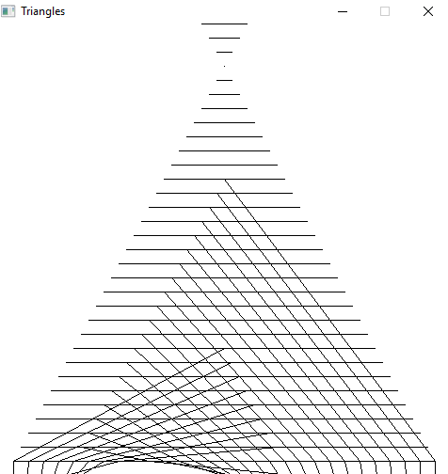
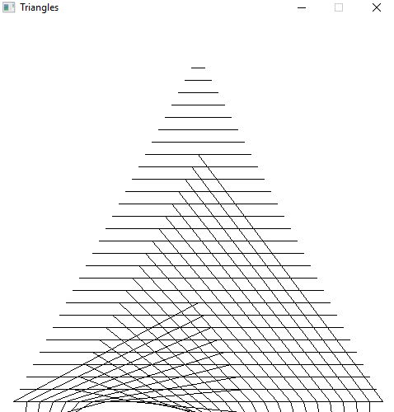
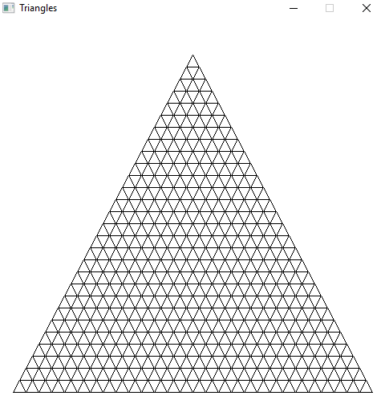
Triangles (all about bugs)

Slide 5
Conclusion
int learningHours = 12;
if (learningHours >= 18){
std::cout<<„You have to sleep more”<<std::endl;
}else if(learningHours <= 8){
std::cout<<„You gonna fail the exam”<<std::endl;
}else{
std::cout<<„Pretty cool huhh?”<<std::endl;
}

Slide 6
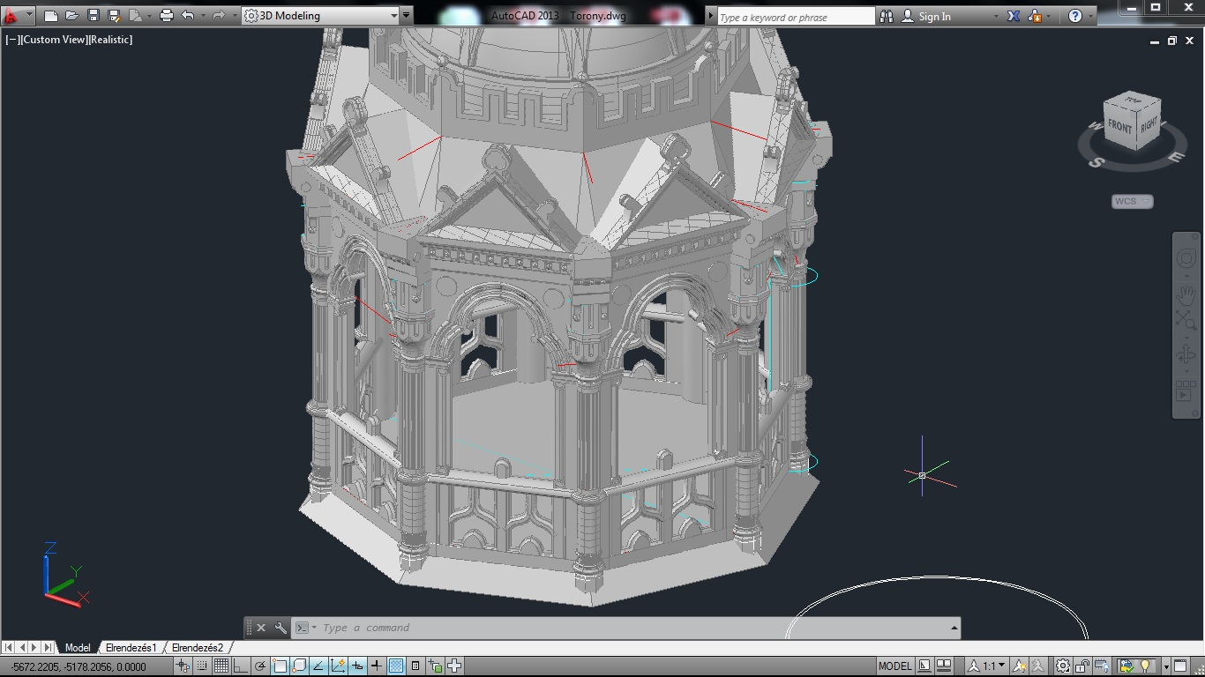
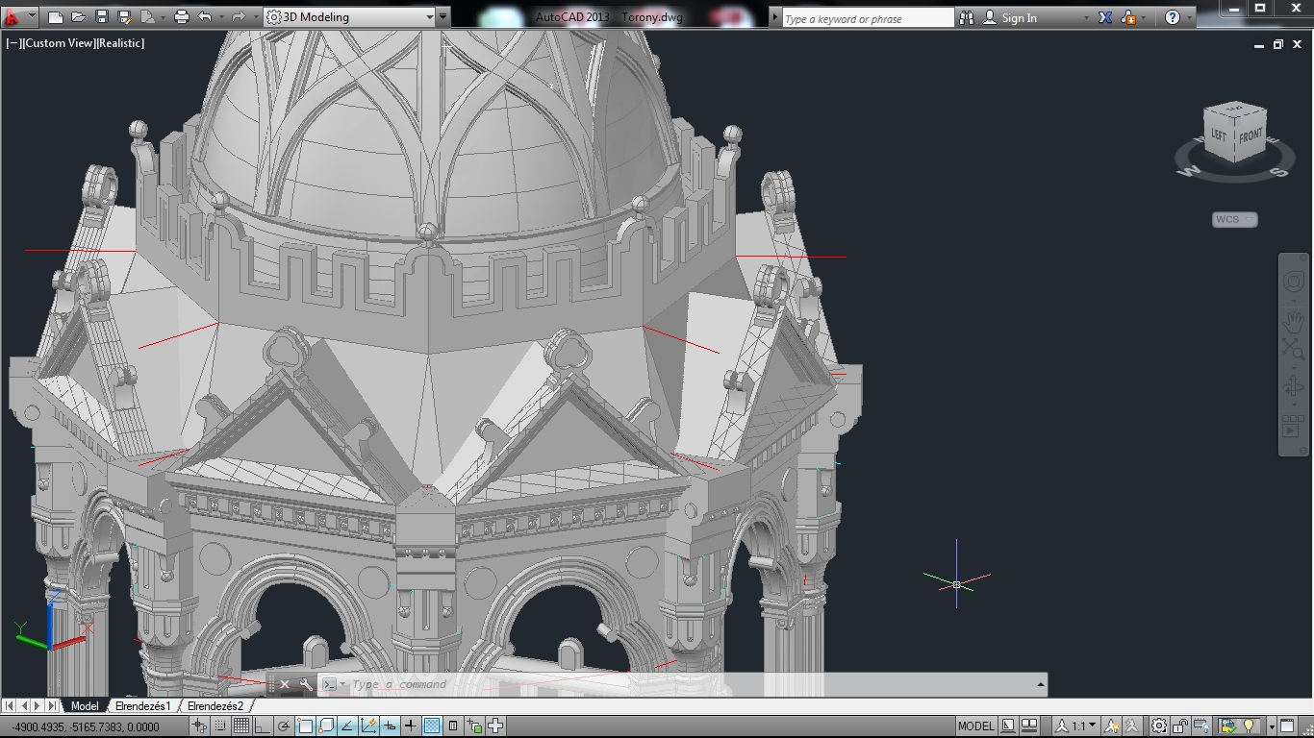
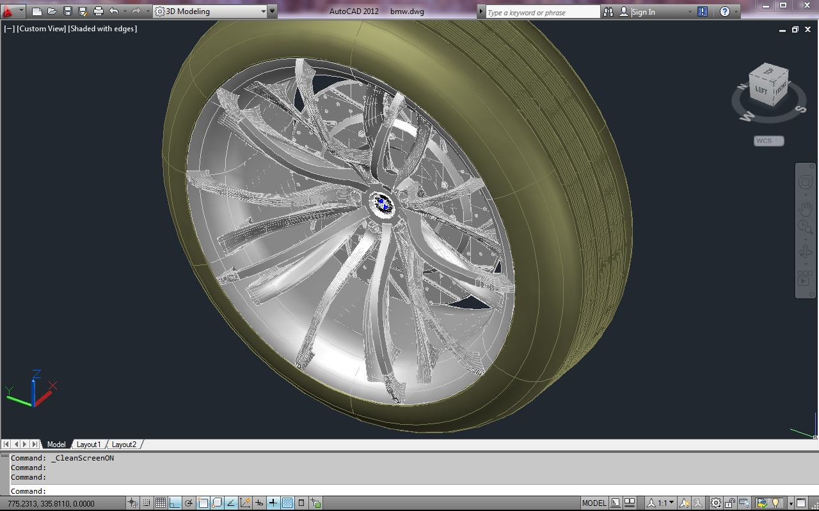
3D drawing…

